Slide 1
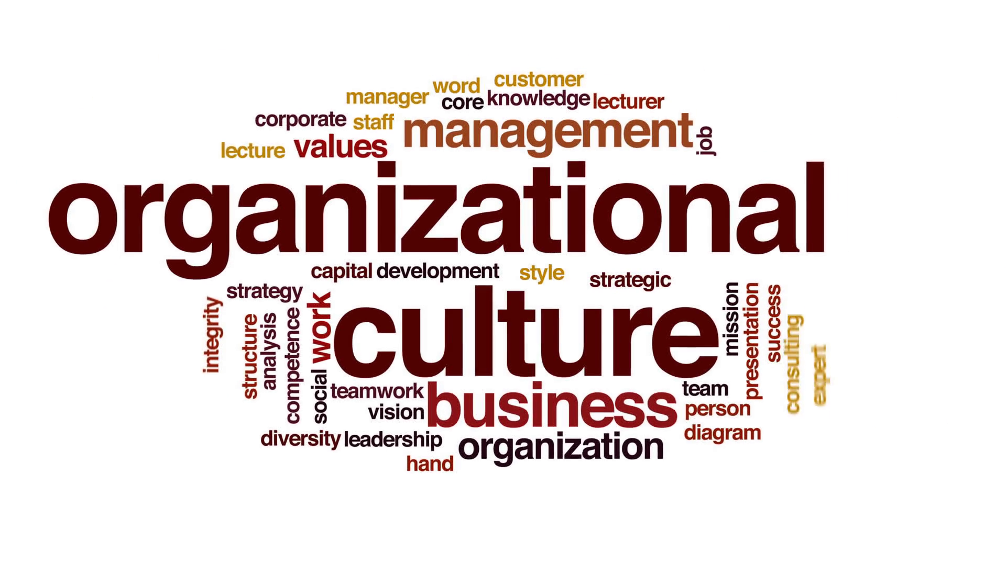
UNIT 5

Slide 2
ORGANIZATIONAL CHANGE
Organizational change is both the process in which an organization changes its structure, strategies, operational methods, technologies, or organizational culture to affect change within the organization and the effects of these changes on the organization.

Slide 3
What Are the Causes of Change in an Organization?
End-of-Life Products
Governmental Priority Change
Mergers and Acquisitions
Business Strategy Change
Business Structure Change

Slide 4
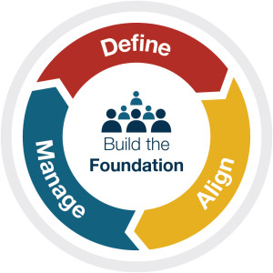
Organizational Culture & Change - Process

Slide 5

Evaluate your current culture and performance
Clarify your initial vision
Clarify your initial vision

Slide 6

Clarify strategic priorities
Engage your team in defining SMART goals
Clarify and track key measures

Slide 7

Maintain a management system for priorities and goals
Manage communication habits and routines
Build motivation throughout the process

Slide 8
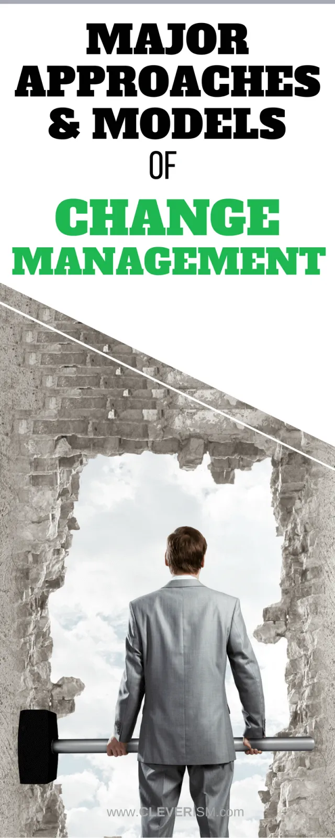

Slide 9
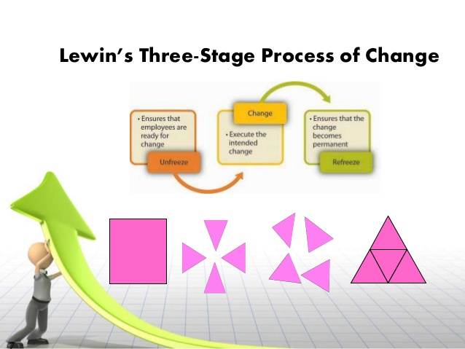

Slide 10
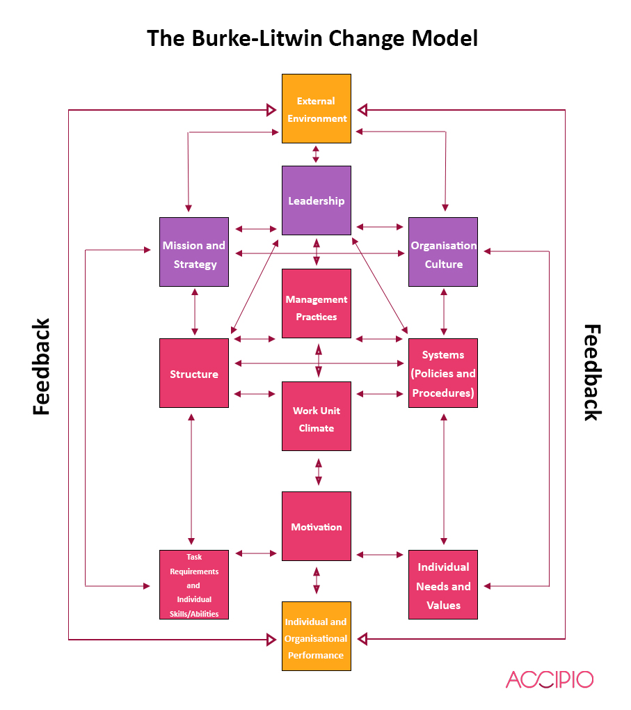

Slide 11
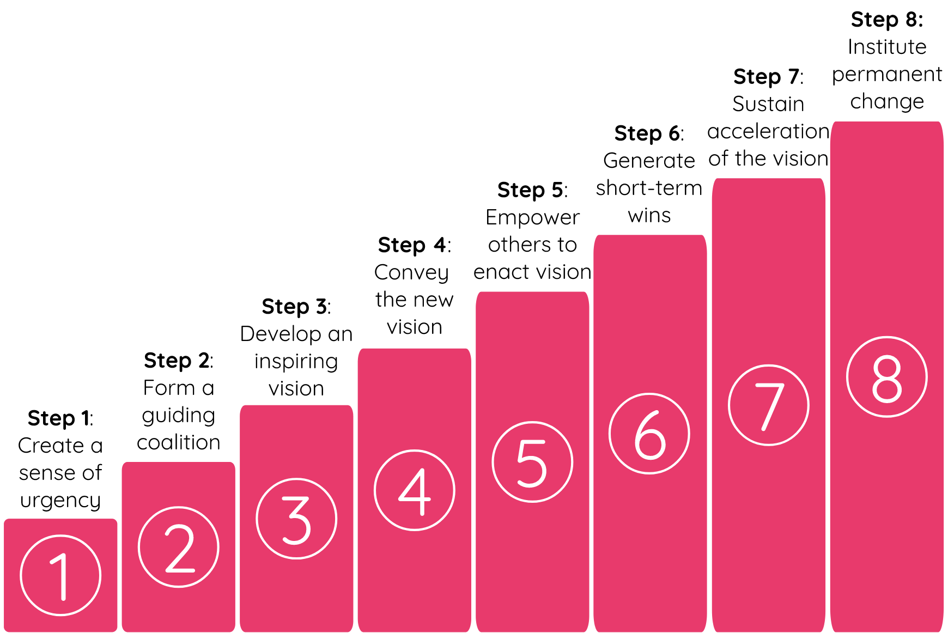
KOTTER’S CHANGE MANAGEMENT THEORY

Slide 12
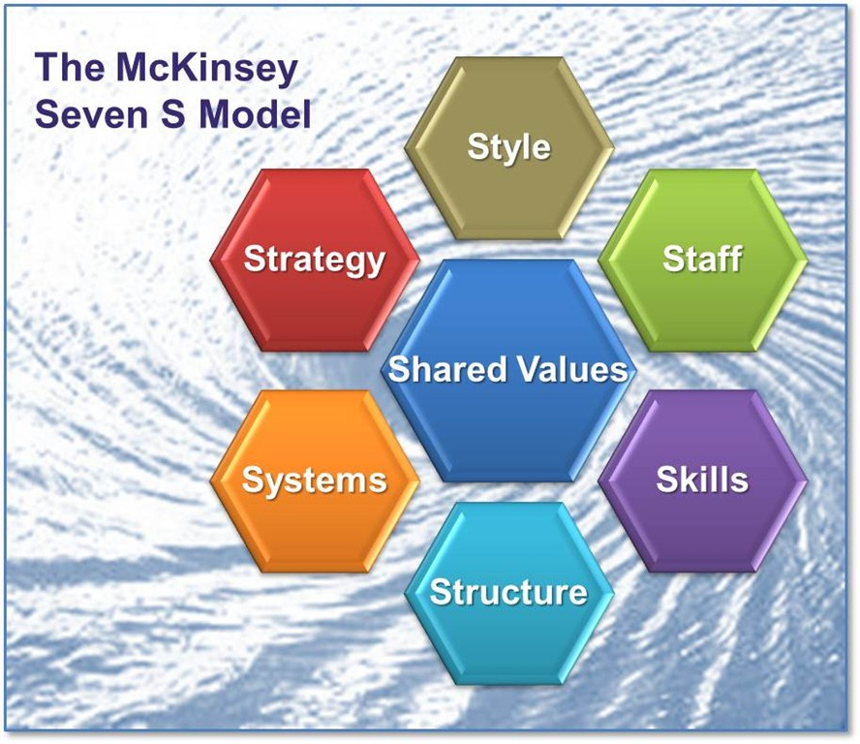

Slide 13
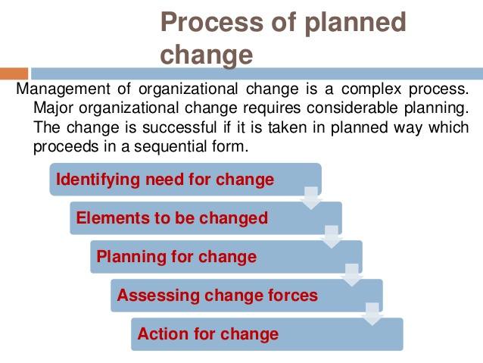
Planned change
Planned change is the process of preparing the entire organization, or a significant part of it, for new goals or a new direction.
This direction can refer to culture, internal structures, processes, metrics and rewards, or any other related aspects.

Slide 14
Reasons for Resistance to Change
Job Loss
Poor Communication and Engagement
Lack of Trust
Poor Timing

Slide 15
How to Overcome Resistance and Effectively Implement Change
Overcome opposition
Implement change in several stages
Communicate change effectively
Effectively engage employees

Slide 16
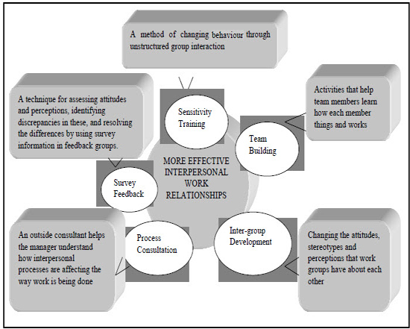
OD INTERVENTIONS

Slide 17
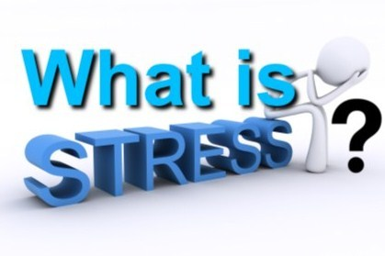
Stress may be defined as "a state of psychological and / or physiological imbalance resulting from the disparity between situational demand and the individual's ability and / or motivation to meet those demands."

Slide 18
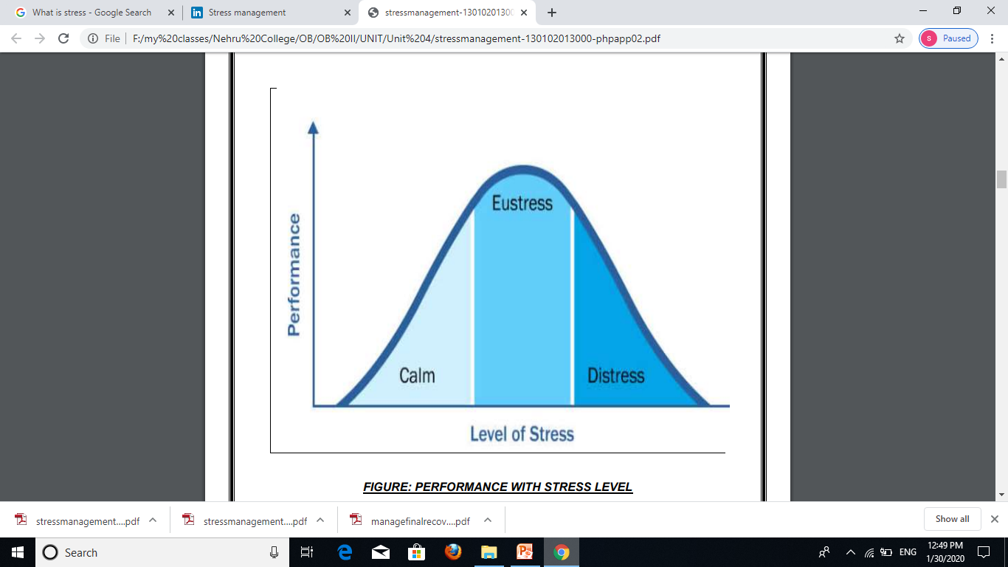
LEVELS OF STRESS

Slide 19
DISTRESS
Bad Stress
Acute Stress
Chronic Stress

Slide 20
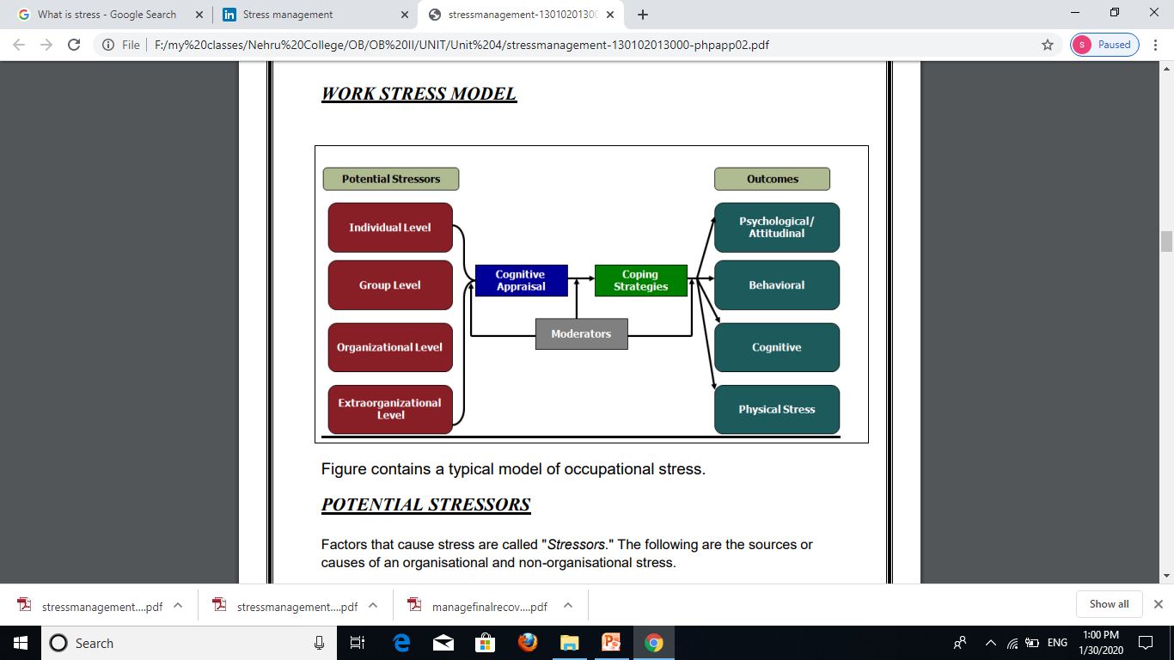
WORK STRESS MODEL

Slide 21
Individual Level Stressors
Career Changes
Career Concern
Role Ambiguity
Role Conflict
Role Overload
Frustration
Life Changes
Personality

Slide 22
Group Level Stressors
Managerial Behaviour
Lack of Group Cohesiveness
Lack of Participation in Decision Making
Interpersonal and Intergroup Conflict
Lack of Social Support
Workplace violence
Sexual Harassment

Slide 23
Organisational Level Stressors
Organisational Climate
Organisational Structure
Organisational Leadership
Organisational Changes
Occupational Demands
Work Overload
Work Under load
Working Conditions

